Slide 1
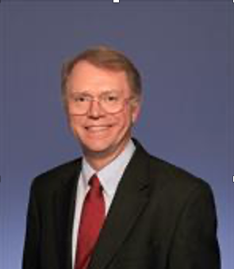

Lessons Learned from the Cerner EHRM Project
Art Wallace, M.D., Ph.D.
Professor and Vice-Chairman UCSF
Chief of Anesthesia San Francisco VAMC
Co-Chair of Cerner EHRM Perioperative Council
Art.Wallace@va.gov

Slide 2
Disclosures
Developed Perioperative Beta Blockade.
Research for Obelab who invented NIRSIT
Developed ECOM.
Research for Sensifree.
CEO and Developer for Atapir
Cardiac anesthesiologist, electrical engineer, biomedical engineer, and have developed software and medical IT software for more than 40 years, board certified in Clinical Informatics.
I have developed three CIS/ARK programs. My first CIS/ARK system was in 1981.
No funding from Medical Informatics Companies.
I am opinionated.

Slide 3
Objectives
The specifications for an electronic health care record (EHR) are extremely important. You get what is written down in the specifications; If it isn’t in the specifications, you likely won’t get it.
The contract for the electronic health care record is extremely important.
Software reflects the purpose and goals of the designer and software engineers.
Most electronic health care records are accounting systems, written by software engineers, with a text editor tacked on.
VISTA/CPRS is an electronic health care record, written by clinicians, with some accounting tacked on.
In anesthesia, record keeping is real time, the user interface matters.
Loss of situational awareness from computer problems is dangerous.
Testing is essential. One must assume that nothing works if it is not tested.

Slide 4
These are my opinions – These are not the opinions of the VA
I have worked on the Cerner EHRM project since 2017.
I was part of the original specification team.
Those specifications were ignored for “more generic ones”.
I am the co-chair of perioperative council (anesthesia chair) since the beginning.
I warned of the risks of this project when the council was the Surgical Council and asked for an Anesthesia Council.
That decision was negated – We will have the same structure as the DOD.
The name was changed from Surgical Council to Perioperative Council. (This cosmetic change doomed the project)

Slide 5
Surgeons
Have fundamentally different electronic health care needs from anesthesiologists.
Surgeons, see patients, write notes, book cases, do surgery, dictate OP notes, write post op notes, write orders.
Surgeons do not use the EHR while doing surgery.
Anesthesiologists do those functions, but also collect real time, continuous data, with real time documentation of infusions, medications administered, during clinical care.
Our EHR needs are fundamentally different.

Slide 6
I have not met a single person in the VA who said….
My clinical care would be better if we replaced CPRS/VISTA with a commercial software electronic health care record system.
My clinical care would be better if we changed our EHR.
We should spend $17 billion dollars on a new EHR.
$1,888 per VA patient.
VA cost per patient at present is $5,000/year.
New EHR would be 37% of health care costs.
What we really need is an inflexible system where nothing can be optimized.
I can’t find a record.

Slide 7
Background

Slide 8
Rationale: “Seamless Interoperability”
The concept was to make the DOD and VA systems be able to exchange patient data.
This concept is fundamentally flawed.
JLV is a higher standard of information access than private sector EHRs. JLV makes viewable over 425 computable fields from VISTA in real time.
Private sector EHRs are not required to exchange computable data. Thanks to EHR vendors pushing back against actual meaningful exchange in the ONC’s “Meaningful Use” HL7 standards, only structured document exchange is required (Continuity of Care Documents, CCDA). Neither computability nor semantics are required nor enforced. While FHIR is a better format (JSON) and transport mechanism (REST APIs) for CCDAs, this does not fix the underlying problem of lack of semantics. Without semantics enforced, data exchanged is meaningless. Not “Meaningful”.
DOD has for very different demographic and mission than VA. Veterans in VA care have a median age of 68 years old. Most Veterans going to the OR are ASA 3 and higher. Active service patients and families in DOD must be deployable and by definition are healthy. DOD care includes pediatrics and obstetrics, none of which VA does.
Very few patients go back and forth from VA to DOD to VA to DOD.
The transfer from DOD to VA is typically many years after military service making the DOD records obsolete.
Even with Cerner implemented in VA and DOD, DOD will not allow VA to see active-duty records for security purposes. Instead, DOD sends 8000 files to VA each night via FTP. VA then has to manually map these to a series of databases to attempt to reconstitute a “health record” This is not available or visible to any VA clinician. This is what EHRM calls “seamless interoperability”. See above what JLV provides.

Slide 9

Risk: Software Project Failures
Number one reason for failure of software development is poor specifications.
Published Predicted chance of EHRM success 7%
With perfect management more than 50% of software projects are complete failures.
100% loss of investment and abandoned.
1:10 Game Development projects makes money.

Slide 10
Specifications?

Slide 11
Cerner EHRM Specifications for Anesthesia
Can I see the DOD specs for Anesthesia?
(“includes Anesthesia”)
That’s it????
The VA specs for the CIS/ARK systems were 150 pages long and took five years of work to develop. Don’t you what those?
“NO”

Slide 12
(“includes Anesthesia”)
Software vendors supply what is in the contract.
If it’s not in the contract, you aren’t going to get it.
There are no usability, functionality, data transfer, analytic, statements in the specification.
There is nothing enforceable in these specifications.

Slide 13
Mission?

Slide 14

What is the purpose of an EHR?
Cerner “Billing”
VA “To exchange information to provide optimal clinical care.”
Cerner “Don’t you want to bill?”
VA “Nope, we don’t really bill.”
If the two parties have a fundamentally different view of what the purpose of the product is, the customer won’t get what they want.

Slide 15

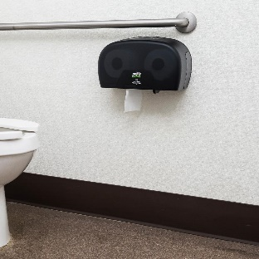
The VA will finally not be on paper records…
We showed Cerner CPRS, VISTA, PICIS, ProtoViewer. They were not interested.
Cerner kept saying “The VA is on paper records.”
We haven’t been on paper records for almost three decades.
Cerner kept saying “The VA is on paper records.”
“The only place we use paper in the VA is in the restroom.”

Slide 16
2017 to Present
2017-2018 Cerner showed us their program.
I went to Kansas City 10 times for a week each time (essentially ¼ of my time).
Cerner showed us their program.
When we identified issues, problems, bugs, missing information, excessive numbers of questions, etc.
Can we change the configuration? “No”
“The DOD has already decided.”
Cerner is still showing us what they have in 2021…

Slide 17
Configuration?

Slide 18
“The DOD has already decided.”
The DOD did not assign anyone to the Cerner Perioperative Council.
One anesthesiologist from DOD was assigned to Perioperative Council after DOD go-live when there were major problems.
All configuration change requests were denied because the “DOD has already decided.”
To make the system compatible with DOD, it has to be the same as DOD.
In 2021, Cerner assigned a Cerner employed CRNA to the anesthesia group. He says Cerner realizes their product is from the last century and has problems and thinks there may be improvements 5 years from now.

Slide 19
“No”
To make the system compatible with DOD, it has to be the same as DOD.”
“To make a change the VA has to agree, then the DOD has to agree, then the Uber Organization above the DOD and VA has to agree.
Can we meet with the Uber Organization above the DOD and VA?
NO. (It doesn’t seem to exist yet).
The time to make a configuration change, after everyone agrees, is more than 18 months. No changes have been made in 4 years.

Slide 20
What requests were denied?
Can we have the diagnosis with the surgical booking?
Could we not display the birth weight?
Could we use consistent terms from screen to screen?
Could we use standard titles for notes?
Could the system indicate an error that will fail to book a surgical case?
Can the system read left-to-right?
Can we use green for good and red for bad?
Could we have fewer than 3000 questions on this screen?
Could we have a font color that isn’t the same as the background so you can read it.
Cardiovascular

Slide 21
How long does it take to fill this out?
“It takes the nurse 90 minutes.”
“Our nurse only has five minutes for this visit.”
“Hire more nurses.”
“We can’t hire more nurses.”
“You should have three nurses per OR to fill out the records.”
Could we have fewer questions? NO
How does the nurse know which of the 3000 questions to answer? Training.

Slide 22
There are three thousand questions here?
In Cerner, a clicked box means the patient has that thing.
In Cerner, a blank box means nothing.
How will the nurse know what to fill out and what to ignore?
Training……
Rather than make the software compatible with people, Cerner expects the VA to make the people compatible with their software.

Slide 23
“NO”
“I have trouble speaking. It is difficult when people interrupt me. Could you not interrupt me and let me finish my question before telling me no?”
“NO”

Slide 24
Why is Cerner so resistant to any configuration?
Despite having access to 500 VA informaticists, with extensive experience in electronic health care records review their product for 18 months, Cerner staff ignored every single suggestion.
Why?
Change costs money.
If they can have one system for DOD and VA with no changes, they don’t have to hire people to do configuration changes. They can sell generic Cerner.

Slide 25
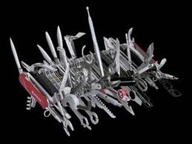

Change Management?
Is usually a problem in software design.
Not a problem for Cerner EHRM.
Cerner solved it by only allowing configuration changes. No new software.
Then they denied even configuration changes.
Then they “lost” all the requests for configuration changes.
Then Booze Allen “lost” all the records of the meetings about the configuration changes.
Finally, all of the $500 million spent on ”configuration” ran out.
This exercise was designed to give the impression that “configuration” was happening.

Slide 26
Why are we meeting to configure the system if we can’t make any changes?
“If a VA policy or procedure is not compatible with Cerner EHRM. We will change the VA Policy to be compatible with Cerner EHRM.” -Decision of senior EHRM management.
Think about this….. We will make our health care system compatible with your software…
Why don’t you just send us a DVD with a demo of the system and then we will be done?

Slide 27
Usability?

Slide 28
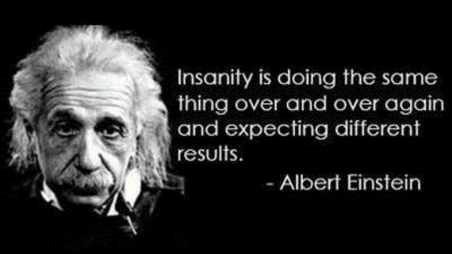
Cerner thinking…..
Cerner: “No one likes PowerForm Notes. They are unreadable. We recommend you use PowerForm Notes. No one likes them or uses them because they are unreadable.
VA: “Why do you recommend them if they are terrible?”
Cerner: “We are told to tell you to use them.”
Cerner: “Notes don’t matter because no one can read them.”
VA: “I will help you fix the notes to make them readable.”
Cerner: “We can’t allow that.”
VA: “Do you think this is a reasonable way to treat the VA.”
Cerner: “No.”
VA: “Why are you doing it?”
Cerner: “We are told to treat you this way.”
Cerner: “We don’t have time to fix the notes, orders, data entry, etc…”
VA: “Let me take the Cerner course so I can fix the notes.”
Cerner: “We are not allowed to let you fix them.”

Slide 29
None of the configuration changes we made last time are here?
This isn’t the version you will get this is the “commercial build, ” or “demo build”, or BH1980 build.”
Can we see how it will look to the clinician?
No.
I can’t tell what it will look like from an Excel spread sheet.
We can’t show you until it’s built.
We don’t have time to make that PowerForm, PowerNote, Dynamic Document.
We don’t have any records of what you requested.
September 17, 2021: Task Order 28 Not Renewed: Cerner Anesthesia Shutdown
We have no funding to listen to your requests or make any configuration changes.
I don’t have permission to see your build.
I’m the Cerner representative who is supposed to help you.

Slide 30

Cerner Experience Center: You can’t experience Cerner EHRM at the Experience Center.

Slide 31
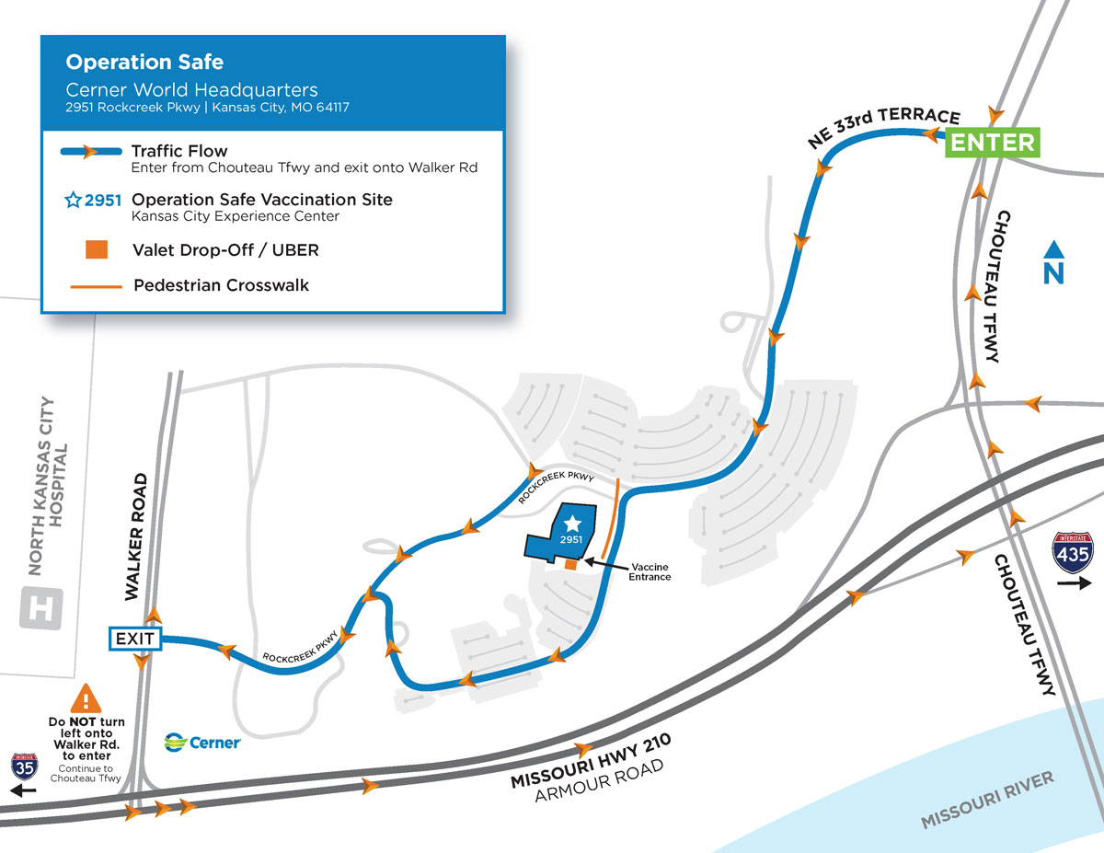
There is a hospital across the street from Cerner that uses EPIC.
Experience Center
Experience Center

Slide 32
Testing?

Slide 33
Can we test it?
Can we see EHRM run in the Experience Center?
“No”
Can we see a hospital with the product running?”
“No”
Can we go to the DOD hospital and see it run?
“No”
Can we install it in our simulation center to test it?
“No”

Slide 34
I believe in testing….
Can we test the Cerner EHRM product? No.
Can we set Cerner EHRM up in our simulation center? No.
Can we set up the Cerner EHRM product in SimLearn? No.
Do you have test patients in Cerner EHRM live? No.

Slide 35
I believe in testing….
Can we test the Cerner EHRM product? No.
It is dangerous to use untested electronic health records in anesthesia. Can we test it? No
Can I see it in DOD? No.
Can we see it in Spokane? No.
We don’t have time to test it.
We don’t have funds for you to go to Spokane.
I will go on my vacation and pay for my own travel.
We don’t have time to test it.
It is dangerous to use untested electronic health records in anesthesia.

Slide 36
It is dangerous to use untested electronic health records in anesthesia.
When we finally were allowed to test the system in Spokane, there were 85 problems that made it unusable.
We told senior EHRM management that it was unsafe to use.
Senior EHRM management decided to proceed with Go-Live anyway to stay on schedule and just use another “DOD” build that was untested.

Slide 37
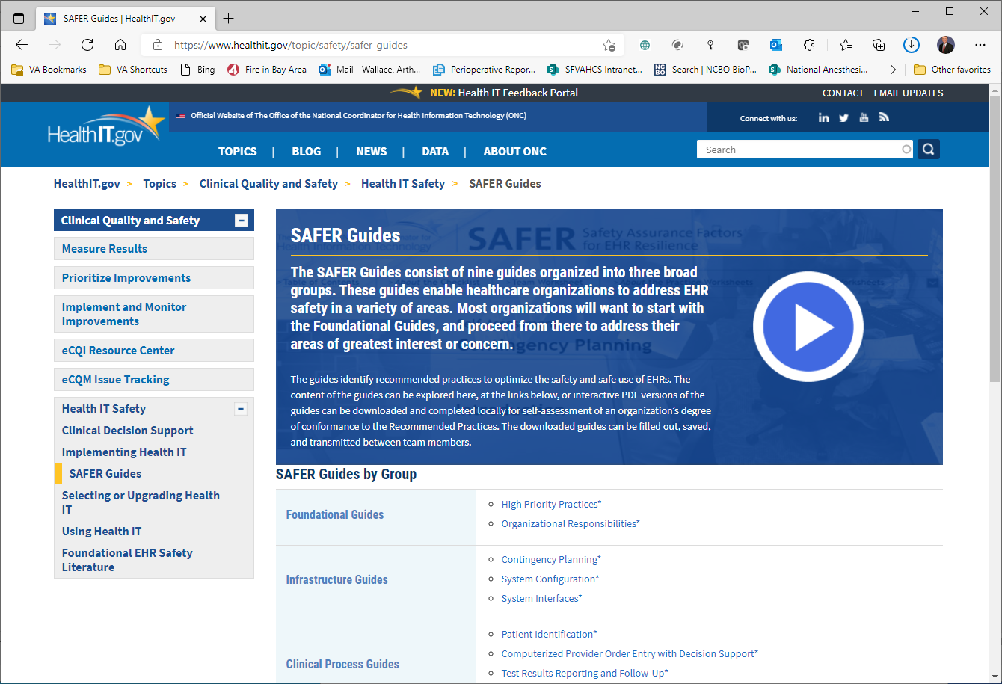
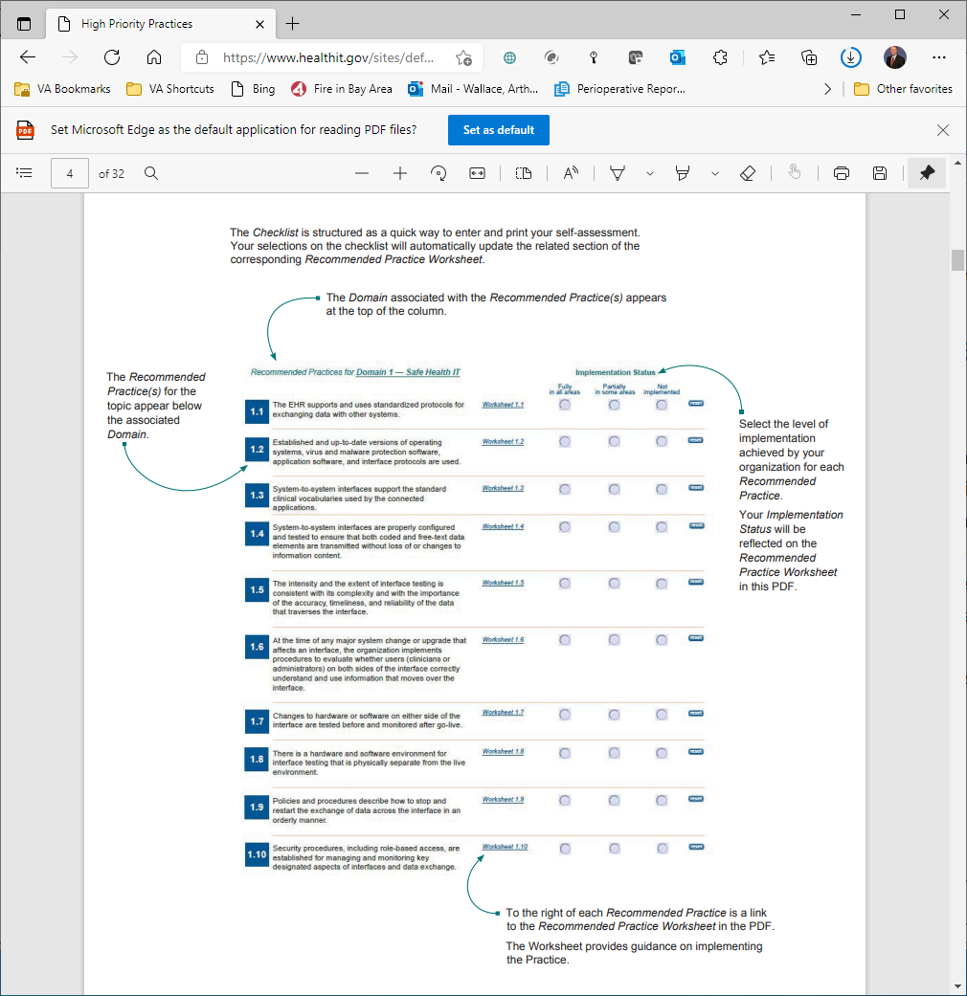
Safer Guidelines
Testing software prior to use is a required element for safety.
1.4
1.5
1.6
1.7
1.8
Cerner and EHRM management did not allow for any actual testing of the anesthesia software prior to go-live.

Slide 38
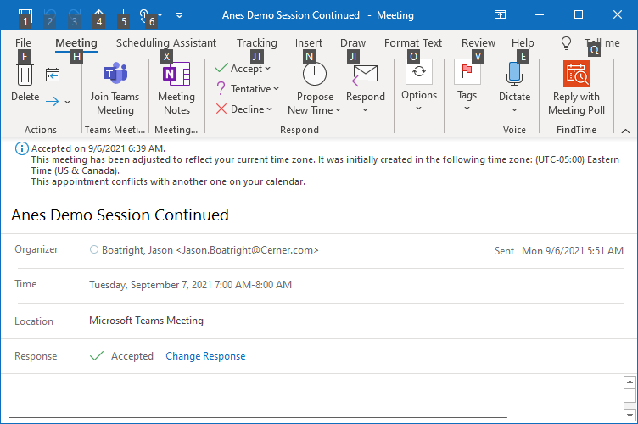
Anes Demo Session Continued?
We began the Cerner EHRM project writing specifications in 2017.
Those specifications were discarded for “more generic, less specific, global concepts.
We showed Cerner the VA Electronic health record system including CPRS, VISTA, PICIS, ProtoViewer, etc. They ignored it.
Cerner then showed us what we are getting.
The answer to all requests for configuration changes was “NO”.
The DOD has already decided. To make the system compatible with the DOD, we can’t change anything.
How many people from the DOD worked on configuration of the Surgical and Anesthesia Packages – None.
So, you provided generic Intermountain Health Build to DOD – Yes.
We are still being shown Demos in October 2021….
None of the configuration decisions made from 2018 to 2021 were implemented.
September 17, 2021: Task Order 28 Not Renewed: Cerner Anesthesia Shutdown
Plan is to fix issues starting 3-4 years from now.

Slide 39
Programmers?
None of the Cerner staff we dealt with were clinically trained.
None of the Cerner staff we dealt with were programmers.
No one I met in more than ten trips to Kansas City could answer the question, what is Cerner EHRM written in?
We did not see product, we saw Excel spread sheets for choosing configurations.
Those choices were “lost”, “not implemented”, “in another build”, “NO”, “the DOD decided”, etc, etc, etc.

Slide 40


Slide 41

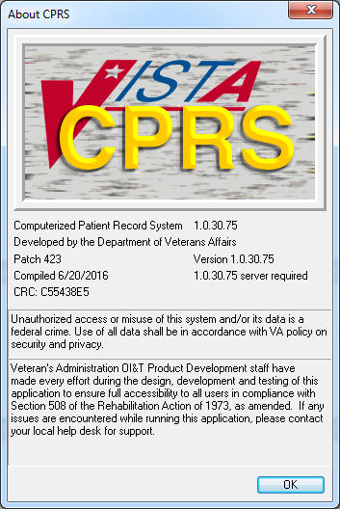
The VA Already has an EHR. VA: CPRS and VISTA
Free for use – open source.
It works.
It is designed by physicians and nurses and pharmacists for clinicians to use.
It is in version 1.0.30.75
(big number ≠ 1)
(ie not version 1).
Used in VA, South America, Jordan, UK, etc.
$40 m/year to use.
$10 m/year to host on AWS for 333,000 users.
Cerner charged $400 million/year to host a test account for 70 people.

Slide 42
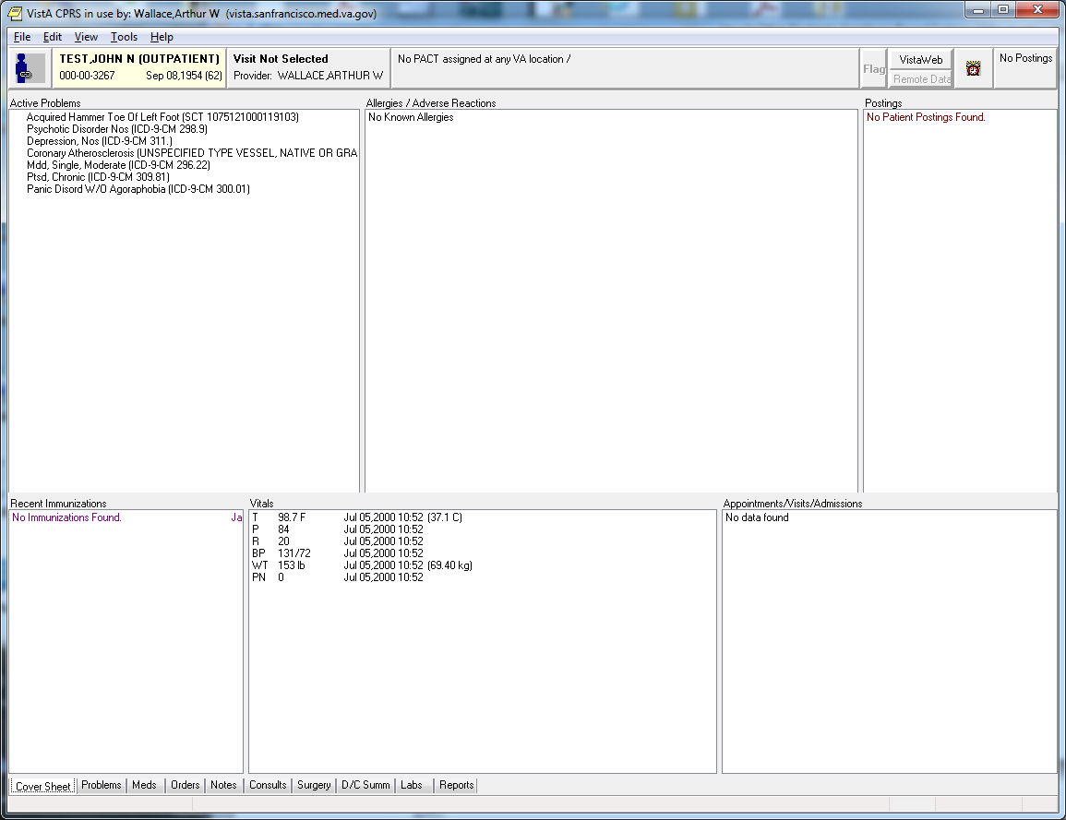
Cover sheet

Slide 43
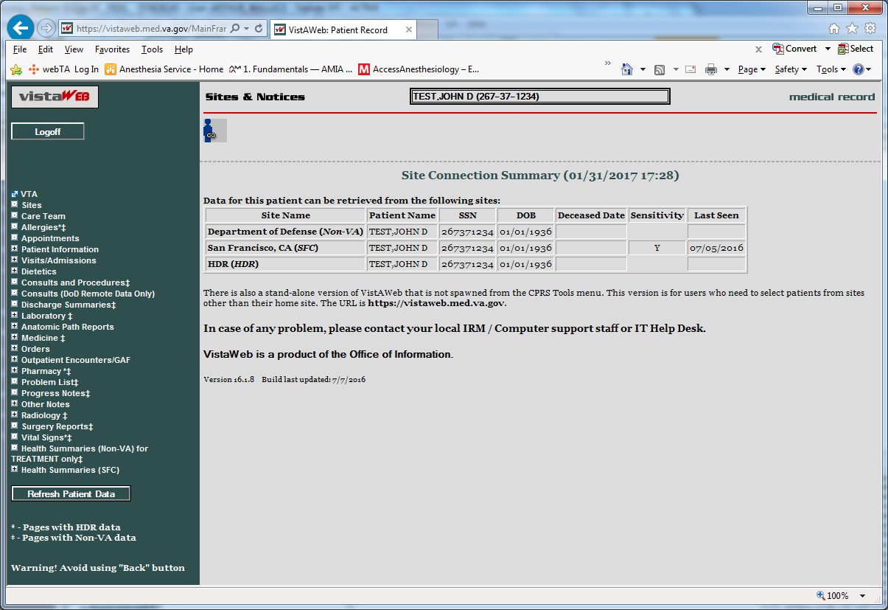
We can already see records across the VA and DOD. Web based tool can display records from every hospital in system (VA & DOD, 1400+ locations).

Slide 44
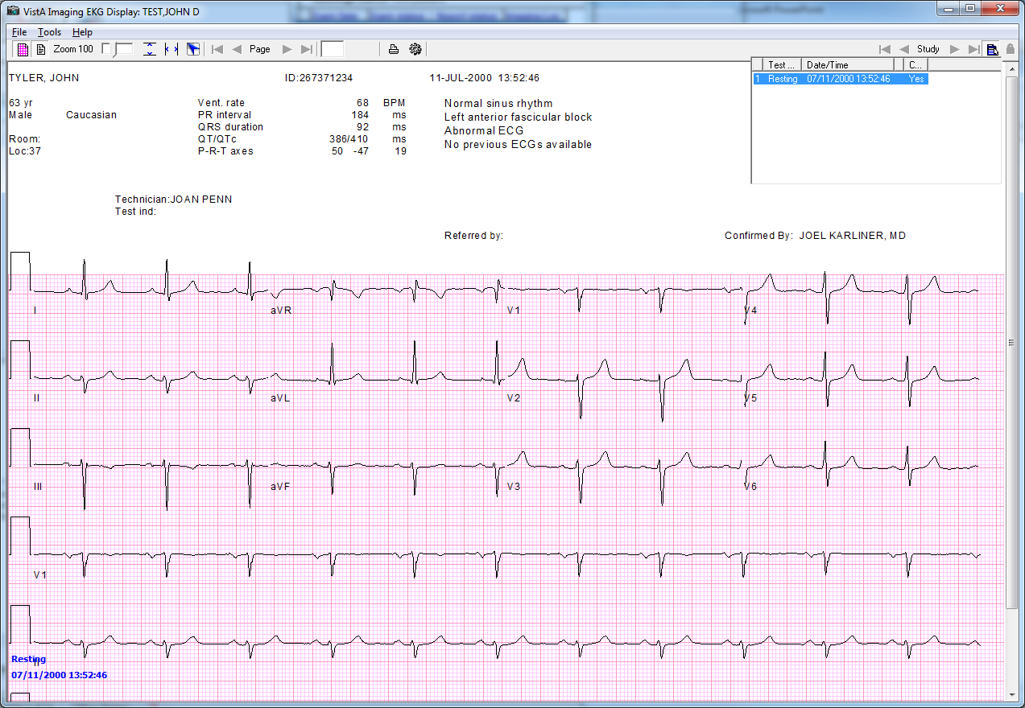
Test Patient

Slide 45
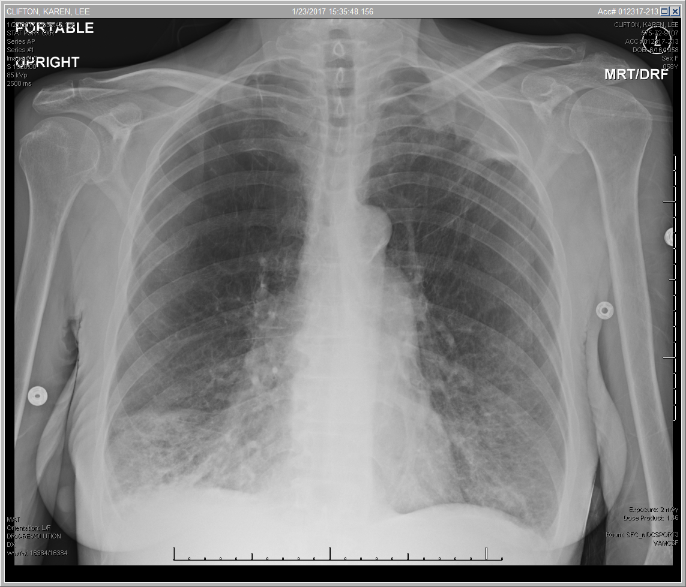
Test Patient
Test Patient

Slide 46
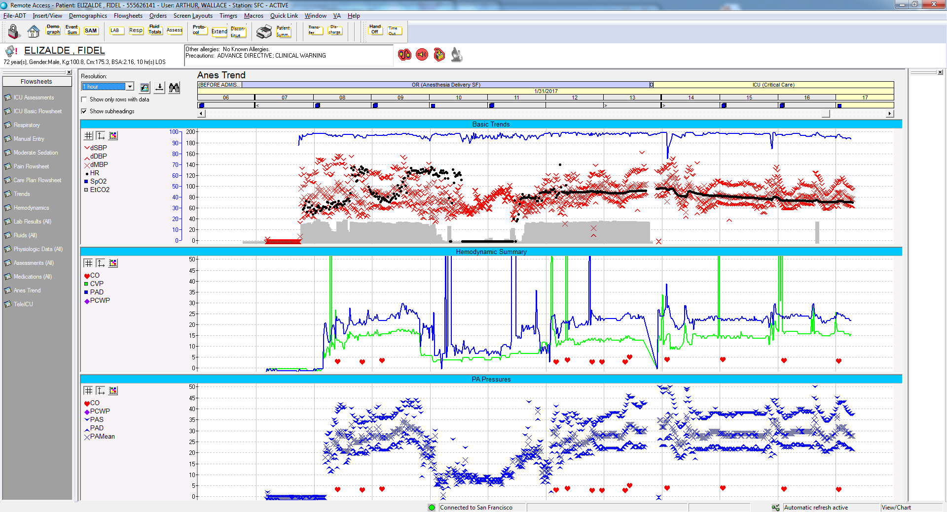
We already have electronic Anesthesia and ICU Records.
Test Patient
Test Patient

Slide 47
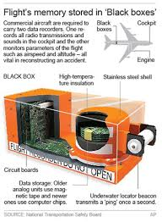
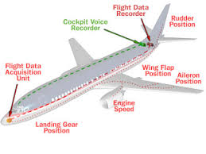
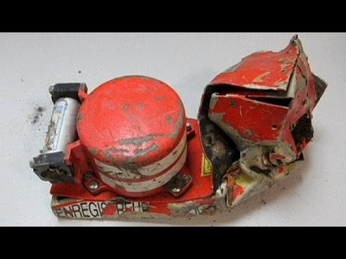
What is benefit of EMR?
Medicine is essentially information processing.
Everyone can see what is happening.
Can control or guide processes of care.
Reduce errors.
Never again say
“Who has the chart?”
“Where is the chart?”.
“I can’t find the chart so I am not quite sure the details of the case.”
Accident investigation: you have the black box flight recorder from every crash!
You know what went wrong.

Slide 48
Why is the VA system wonderful?
It was written by clinicians for clinicians.
Most electronic medical records (EMR) systems were developed for accountants to send bills. Someone tacked on a word processor and called it “A Clinical Information System”.
You want a system designed by clinicians (MD, RN, CRNA, Pharmacy, etc), maintained by clinicians, tested by clinicians who are actually providing clinical care.
What seems reasonable to a person who is not providing care, is intolerable to those of us who do.
CPRS was designed by someone who thinks like you.
CPRS menus, notes, etc can be changed in less than 1 hour. Cerner changes take more than 2 years.

Slide 49
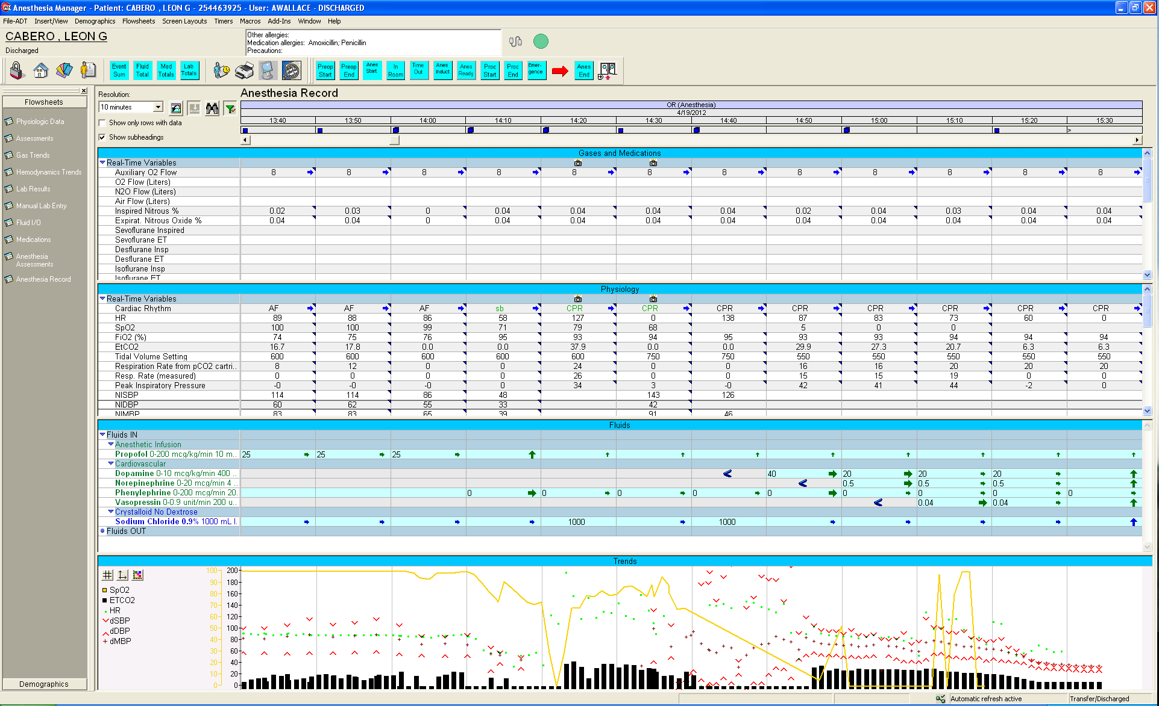
78 year old male with h/o CAD, s/p CABG 1980s, recent NSTEMI, CHF, PVD s/p Fem-Pop bypass, HTN, HLD, COPD on home oxygen, GERD, anemia, hypothyroidism, CaP, thalamic CVA, and ESRD on HD s/f Left forearm AV Fistula loop graft. ASA 4 You can figure out what really happened.

Slide 50
Problems with Cerner EHRM
Cerner is selling a database for billing.
The physician and nurse are data entry clerks for a billing machine.
No changes are allowed.
If a VA policy or procedure is not compatible with Cerner EHRM. We will change the VA Policy to be compatible with Cerner EHRM.
The VA wants to exchange information to provide the best care possible.

Slide 51
VA Staff Opinions.
“This is going to be an EPIC Failure, the VA is Committing Cerner-Cide”
“I’m going to retire before go-live.”

Slide 52
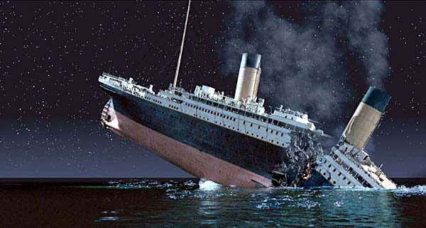

“This is going to be an EPIC Failure, the VA is Committing Cerner-Cide”

